Slide 1
The Chemistry of Germanium, Tin and Lead
Anil J Elias, IIT Delhi

Slide 2
Germanium
The unique optical properties of germanium are, highest refractive index (4.003) for any glass forming material and low optical dispersion. These properties make it useful as an additive to reduce attenuation (reduction in power of light signal) of fibreoptic cables used in telecommunication.
Germanium is the material from which the first transistors were made. A tin-doped germanium rectifier diode for solid state signal processing was found to be highly resistant to burnout by stray voltages during the second world war. It was extensively used as a semiconductor material (band gap 0.67 eV at 273 K) from 1940–1960.
Modern day germanium-containing semiconductors find use in mobile phones and hand held devices as they consume much less power and are much faster than conventional semiconductors.
Its use as a semiconductor declined considerably after the advent of silicon-based semiconductors as silicon was inexpensive; large scale and very large scale integrated circuits (VLSI) were made readily from silicon.
Germanium and germanium-based glasses transmit near IR radiation more effectively than silicon. This property made it useful in the making of passive night vision lenses which use heat radiated by objects to view them in the dark.

Slide 3
GeO₂ is extensively used as a catalyst for the manufacture of polyethylene terephthalate (PET) as unlike PET made using antimony-based catalysts, the mineral water bottles made out of PET polymerised using GeO₂ retain transparency and do not turn yellow with time.
Germanium (II) compounds, often prepared from GeCl₂.dioxane are more stable compared to Si(II) compounds.
The first stable germanone (heavier analogue of a ketone), (Eind)₂Ge=O with a tri-coordinate germanium was prepared in 2012 using sterically hindered substituents on the germanium.
Tin
Bronze, an alloy of tin and copper was the first alloy to be used on a large scale since 3000 BC. After 600 BC, pure metallic tin was produced.
An important application for tin is corrosion-resistant tin plating of steel especially for making cans for storing food without decomposition.
Tin has the second lowest melting point (232°C) among air- and moisture-stable solid metals (comparable melting points: aluminium 660°C, zinc 419.5°C, lead 327.5°C, cadmium 321°C and indium 156.6°C). Lower melting points than tin are only for alkali metals which are moisture sensitive also mercury, gallium and indium. Indium has a very low natural abundance and is an expensive metal.

Slide 4
The low melting point, good natural abundance, air and moisture stability and ease of forming flexible alloys makes tin a sought after metal for making low melting alloys especially solders. All well known lead-containing and lead-free soldering alloys have tin as a major component, most notably tin/lead soft solders, which are typically 60% or more tin.
In 1810 Peter Durand, a British merchant, received the first patent for preserving food using tin cans. Durand made containers out of tinplate which was made out of wrought iron sheets coated with tin to prevent rusting.
Stannous chloride, easily prepared by the reaction of tin and HCl is a well known reducing agent for organic transformations such as, nitro to amino groups and nitrile to aldehyde groups.
While tin and its inorganic salts are generally found to be nontoxic, organic tin compounds have a high level of toxicity. Some of the organotin compounds have been used as biocides especially bis-tributyltin oxide (TBT).
Tributyltin hydride, n-Bu₃SnH with a weak Sn–H bond (74 kcal/mol) is a very useful reagent in organic synthesis for the conversion of C–X bonds to C–H bonds by a free radical mechanism.
Niobium–tin is a superconductor with a critical temperature of 18 K and critical magnetic field of 24.5 tesla. This is useful for constructing superconducting magnets which can withstand high current densities (200,000 A/cm²) at the highest working magnetic field of 15 T. Although it is brittle, magnetic coils are made by wrapping separate strands of niobium in tin and then fusing them to make the alloy. Another well-known intermetallic compound of tin is indium tin oxide (ITO) which is the most widely used transparent conducting oxide.

Slide 5
Lead
The high density, low cost, ease to work with, makes lead the most suitable material for use in radiation shielding. Gamma radiation, being high-energy photons, is difficult to stop. However, this is achieved with lead blocks of 30 mm thickness.
The most important application of lead is in lead–acid storage batteries for which more than 85% of the lead produced in the world is currently used. According to an estimate by the Environmental Defense and the Ecology Center of Ann Arbor, Michigan, USA, the batteries of vehicles on the road in 2003 contained an estimated 2,600,000 metric tons of lead. The auto industry uses over 1,000,000 metric tons every year, with 90% of it going to conventional lead–acid vehicle batteries.
Tetraethyllead (TEL) was one of the most widely used antiknock additives of gasoline. The use of TEL has been stopped in the developed and developing countries due to lead poisoning. The use of catalytic converters and newer model cars to meet tighter emissions regulations, started a gradual phase-out of leaded gasoline. Currently TEL is used only in a few grades of aviation gasoline and in a handful of less developed Asian and African countries.
Lead poisoning is one of the common problems associated with the use of lead compounds. The upper limit for blood lead for adults is 10 µg/dl (10 µg/100 g) and for children it is 5 µg/dl.

Slide 6
Relative natural abundance on the earths crust of group 14 elements are as follows which indicate the rareness of germanium
Carbon 0.18%
Silicon 27%
Germanium 0.00014%
Tin 0.00022%
Lead 0.00099%
The major end uses for germanium, worldwide, were estimated to be fiber-optic systems, 30%; infrared optics, 25%; polymerization catalysts, 25%; electronics and solar electric applications, 15%; and other (phosphors, metallurgy, and chemotherapy), 5%.
The main compounds of commercial importance of germanium are germanium tetrachloride and germanium dioxide. Unlike silicon, germanium forms stable divalent compounds like GeCl₂ and GeO. A major difference with silicon is the fact that it forms GeCl₆²⁻ and GeCl₃⁻.
Zone-refined crystalline germanium typically is 99.9999 percent pure and impurities are typically less than 100 ppb, and electrically active impurities, less than 0.5 ppb.

Slide 7
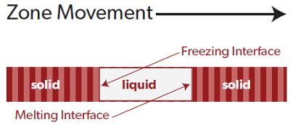
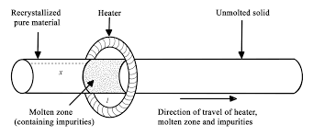
GeO₂ is dissolved in concentrated HCl to make germanium tetrachloride (GeCl₄) which is a fuming liquid similar to SiCl₄ having a boiling point of 86.5 °C. The GeCl₄ is purified by fractional distillation in glass or fused quartz equipments. The purified GeCl₄ is hydrolyzed with deionized water to yield GeO₂. After drying, the GeO₂ is reduced with hydrogen at 760° C to form germanium metal powder, which is then melted and cast into bars, known as first-reduction bars. These bars are then zone-refined to polycrystalline metal that typically contains less than 100 ppb total impurities and less than 0.5 ppb electrically active impurities.

Slide 8
Six salient properties of germanium which differ from that of silicon makes the foundations for all its applications. These are
Intrinsic semi-conductivity
Infra red transparency (ability to transmit near-IR radiation in the 1,600- to 23,000-nm range)
Glass forming ability of Ge-O tetrahedra forming extended three dimensional structures.
Highest refractive index (4.0026) which is the highest for any glass forming material.
Low chromatic dispersion (variation of refractive index with wavelength)
Ability of GeO₂ to catalyze polymerization of terephthalic acid.

Slide 9
Germanium versus silicon in semiconductor device making
Property SILICON GERMANIUM
Bandgap eV 1.1 0.7
MOSFET Yes No
Metal Oxide Semiconductor Field Effect Transistor (SiO2 good (GeO2 unstable with Ge, water insulator) soluble, low melting)
Temp range upto 120-150 °C upto 70-85 °C
Cost inexpensive expensive
Electron mobility 1500 3900
(cm²/V-s)
Hole mobility 475 1900
(cm²/V-s)

Slide 10
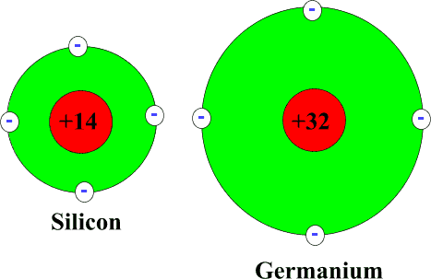
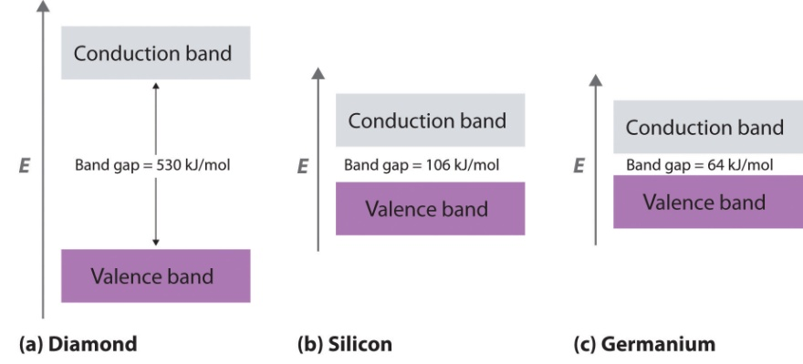
Intrinsic semi-conductivity
Band gap Si 1.1 eV
Ge 0.67 eV
SiO₂ 9.0 eV
Germanium containing semiconductors find use in mobile phones and hand held devices as they consume much less power and are much more faster than conventional semiconductors.
Germanium diodes are best used in low-power electrical circuits. The lower forward-bias voltage results in smaller power losses and allows the circuit to be more efficient electrically. Germanium diodes are also appropriate for precision circuits, where voltage fluctuations must be kept to a minimum. However, germanium diodes are damaged more easily than silicon diodes.
For metal-oxide-semiconductor field effect transistor (MOSFET), GeO₂ is not effective as the oxide interfaces show considerable higher defect densities. GeO₂ has a lower melting point than SiO₂ and it is soluble in water making it vulnerable to humidity variations. GeO₂ also combines with Ge to form GeO, which is volatile and can escape.

Slide 11
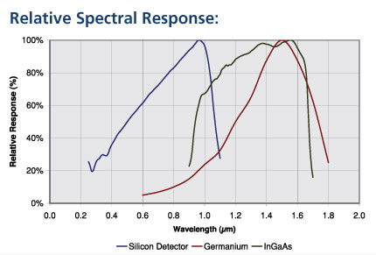
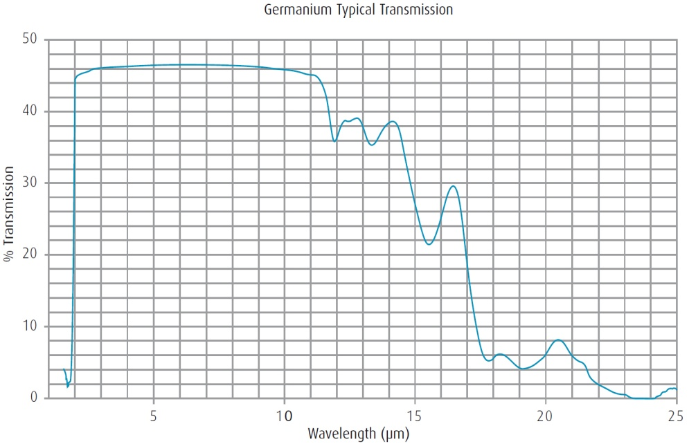
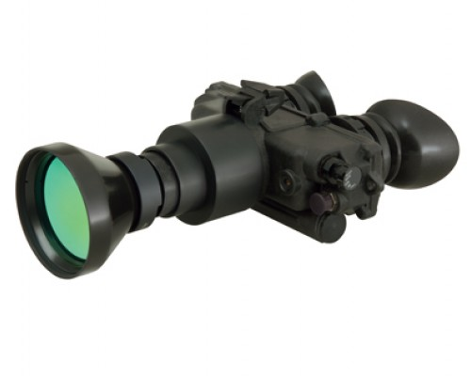


Germanium lenses for infrared night vision
10,000nm
23,000nm

Slide 12
Devices which are thermal imagers are sometimes referred to as forward looking infrared (FLIR) devices and are different from active system IR devices. Active night vision systems emit infrared radiation and measure the reflected radiation differentially from objects in the field of view. In contrast, FLIR devices form images by sensing the thermal contrast between objects and their background. Therefore FLIR devices are suitable for working in complete darkness and are not affected by smoke.
In military use, passive devices made of germanium are preferred as they are rugged and not locatable by the enemy while the radiation emitted from an active device makes it locatable. Germanium-based FLIR systems are used in night vision goggles, surveillance cameras, gunsights, and IR- heat seeking missiles. It also finds use in detecting overheating bearings, fire fighting under thick smoke, satellite mapping, detecting faults in structural materials etc.

Slide 13
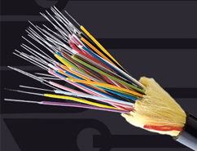

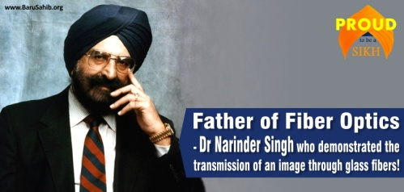
Fiber optic cables for data transmission
A fiber optic cable consists of a bundle of glass threads, each of which is capable of transmitting messages modulated onto light waves. Fiber optics has several advantages over traditional metal communications lines: Fiber optic cables have a much greater bandwidth than metal cables
Fiber optic cables are much thinner and lighter than metal wires.
Fiber optic cables have a much greater bandwidth than metal cables. This means that they can carry more data.
Fiber optic cables are less susceptible than metal cables to electromagnetic interference.
Data can be transmitted digitally (the natural form for computer data) rather than analogically.
Narendra Singh Kapany coined the term fiber optics in 1960. Kapany first demonstrated successfully that light can be transmitted through bent glass fibres during his doctoral work at the Imperial College of Science in London in the early fifties, and published the findings in a paper in Nature in 1954. Nobel Prize of 2009 went to chinese born Charles K Kao !!

Slide 14
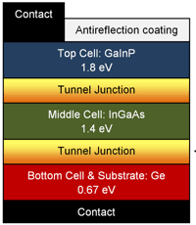
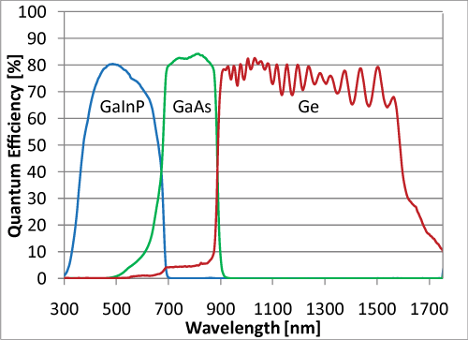
Optical fibers are essentially transparent glass fibers, through which light can be transmitted. In order to be able to transmit data over long distance, light in the near infrared part of the spectrum is chosen often. This is because this part of the spectrum experiences the lowest losses while traveling in glass.
Germanium has the property such that the bandgap energy is approximately equal to the energy of photons in the near infrared. This means that if you shine light of this wavelength onto a germanium diode, you can excite electrons, and produce a current. Therefore, germanium diodes are used as photodetectors to detect near-infrared light for telecommunication applications.
Lasers made out of germanium diodes that are capable of producing near infrared light can be used to send data over long distances. Fiber optic transmission wavelengths are determined by two factors: longer wavelengths in the infrared for lower loss in the glass fiber and at wavelengths which are between the absorption bands. Thus the normal wavelengths are 850, 1300 and 1550 nm.
Germanium diodes are used in multijunction solar cells for absorbing the IR light and converting it into electricity.

Slide 15
Fiber-optic cables enable us to surf on high-speed internet, make phone calls and receive television. They are the backbone of modern telecommunications networks. The term attenuation is used to describe the reduction in power of light signal as it is transmitted over long distances. The cause of attenuation is often related to components such as nature of cables, cable splices and connectors. Early samples of fiber optic cables suffered from considerable attenuation. Reduction of attenuation is very significant as it will help to reduce the number of signal booster units needed in a long distance cable.
Donald B. Keck of Corning glass company experimented with different glass compositions and methods of heat treating the glass to reduce attenuation. Corning had kept a target of achieving attenuation below 20 db/km. In August 1970, Keck prepared a new batch and took measurements of the of the fibers. He observed that light passed through a 65 foot glass fiber without any measurable loss, he exclaimed "Good grief, what do I have here?" More measurements of this optical fiber indicated that it had an attenuation of 16 db/km, exceeding the company’s goal of 20 db/km. Keck and coworkers had invented the first low-loss optical fiber which was composed of titanium-doped silica.
Keck continued to improve upon the optical fiber he had invented. He had a much better result when here placed the titanium oxide doped glass of 1970 with germanium oxide doped glass, and eventually achieved a consistent and much lower 4 db/km attenuation by June 1972.

Slide 16
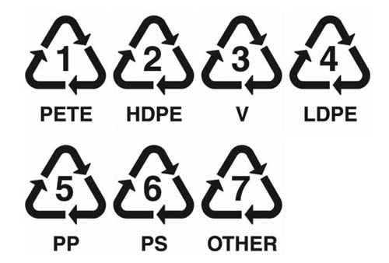
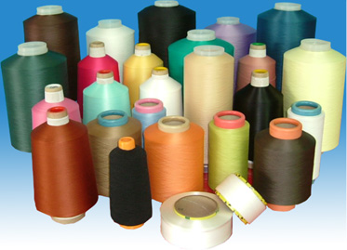
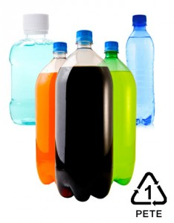
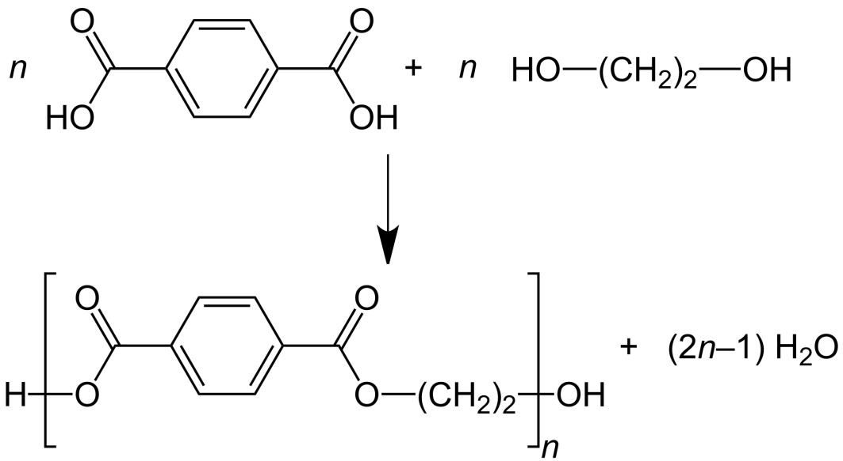
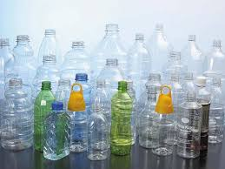
GeO₂ as catalyst for PETE polymerization
Polyethylene terephthalate abbreviated PET, PETE is the most common thermoplastic polymer resin of the polyester family and is used in fibers for clothing, containers for liquids and foods and thermoforming for manufacturing
It may also be referred to by the brand name Dacron; in Britain, Terylene
GeO₂ as polymerization catalyst yields a product with better transparency and whiteness than do other catalysts. Sb₂O₃ or antimony triacetate [Sb(CH₂COO)₃] were used initially, but PET made with these were found to give undesirable yellow color especially with ageing.
GeO₂

Slide 17
Bond | Bond dissociation energies (kJ/mol) | Bond | Bond dissociation energies (kJ/mol
C-C | 346 | C-O | 358
Si-C | 318 | Si-O | 462
Ge-C | 238 | Ge-O | 326
Sn-C | 192 | Sn-O
Pb-C | 130 | Pb-O
Unlike the silicon compound D₄ ,its germanium analogue is highly soluble in water. Cryoscopic measurements on a dilute aqueous solution give a molecular weight corresponding to one Me₂GeO unit possibly resulting in the diol Me₂Ge(OH)₂. A white fibrous material was obtained when the aqueous solution of (Me₂GeO)₄ was evaporated possibly forming a high polymer (Me₂GeO)_{n.} This high polymer is insoluble in common organic solvents but dissolves in water.

Slide 18
Germylene
synthesis
Germylone
synthesis

Slide 19
Digermenes
The first example of a compound with a germanium–germanium double bond (digermene) was prepared by the Grignard reaction of MgClR(OEt)₂ where R = CH(SiMe₃)₂ with GeCl₂.dioxane by Lappert and coworkers in 1984. The compound with the double bond, stabilised by bis(trimethylsilyl)methyl groups was bright yellow in colour and showed a Ge=Ge distance of 2.347 Å when analysed by X-ray diffraction studies. However, this compound was found to dissociate to the corresponding singlet germylenes in solution.
Following this work, bis(2,6- dimethylphenyl) substituted digermenes were prepared by Masamune by first preparing the cyclic trigermane and then converting it to the digermene by photo-conversion using a mercury lamp. The analogous yellow coloured tetrakis(2,6-diethylphenyl)digermene was also prepared and structurally characterised with a Ge=Ge bond distance of 2.213 Å.¹² This digermane was found to retain its structural integrity in solution as a reaction with MeOH was found to add across the double bond.

Slide 20
Synthesis of digermynes
Multiple bonded germanium, tin and lead compounds which are formal analogues of acetylenes have also been prepared by using sterically hindered substituents such as terphenyl(C₆H₃-2,6-Dipp₂; Dipp = C₆H₃-2,6-i-Pr₂).¹³ These compounds have been found to show trans bent geometry with varying amounts of non-bonding electron density on the Ge, Sn and Pb atoms
The strength of the multiple bond is reduced due to the removal of electron density from the region between the two participating atoms. In fact the Ge–Ge distance of 2.285 Å of this compound is shorter than the Ge–Ge single bond distance (2.44 Å) and longer than the calculated distance of 2.197 Å of MeGe≡GeMe. On the other hand, the Pb–Pb bond distance is significantly longer than those found in structurally characterised single bonded diplumbanes which fall in the range 2.85–2.95 Å. However, the distance of 3.188 Å is significantly shorter than the interatomic distance of 3.49 Å of metallic lead. The M–M bonds are therefore not triple bonds but almost double bonds for Ge and Sn, and single bond for Pb

Slide 21
Compound | M–M (Å) | M–C (Å) | M–M–C (°)
Ar´GeGeAr´ | 2.285 | 1.996 | 128.67
Ar´SnSnAr´ | 2.668 | 2.191 | 125.24
Ar*PbPbAr* | 3.188 | 2.303 | 94.26
The example of a digermyne having a single bond and two lone pairs was prepared by Jones and coworkers where the Ge–Ge distance of 2.709 was 0.4 Å longer than other digermynes and more than the sum of two germanium covalent radii (2.44 Å). The molecule also undergoes addition with H₂ further supporting the single bond character of the Ge–Ge bond.

Slide 22
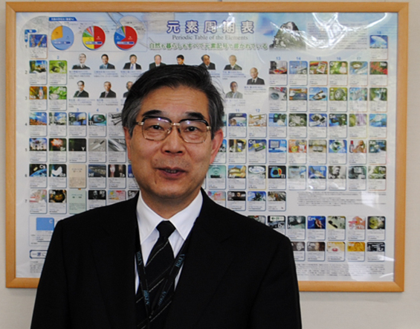
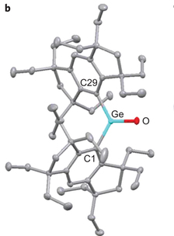
2012
K Tamao
The first isolation and characterization of a stable monomeric germanium ketone analogue (Eind)₂Ge=O (Eind = 1,1,3,3,5,5,7,7-octaethyl-s- hydrindacen-4-yl) having a planar tricordinate germanium was achieved by K. Tamao and coworkers in 2012

Slide 23
The Ge=O double bond length is 1.645 Å which is 6% shorter than the typical Ge-O single bond length of 1.76 Å (B.O 1.252) Computational studies and chemical reactions suggest that this Ge=O is highly polarized with contribution from a charge separated form (Eind)₂Ge⁺-O⁻ as well. The Ge=O stretching frequency was observed at 916 cm⁻¹ in the infra red spectrum. This germanone exhibits unique reactivity which is not shown by ordinary ketones.

Slide 24
First metal complex of the Ge=O double bond
S. Nagendran et al., Angew. Chem. Int. Ed., 2016, 128, 7873

Slide 25
Stable germanium analogue of vinylidene
Vinylidene (CH2=C) or ‘methylidene carbene’ is an isomer of acetylene but has only been observed transiently and has a very short life time close to 10⁻¹⁰ seconds. It has only been known to exist as a transient species under high vacuum and/or high temperature conditions.
Difluorovinylidene, CF2=C, the fluoro analogue of vinylidene is slightly more stable and hasbeen generated and investigated spectroscopically at 15K in an argon matrix. Free vinylidenes that are stable at room temperature were not known till the discovery of a germanium based vinylidene which was prepared by A. Rit et al. in 2016.
The reaction of the NHC stabilised (boryl)germanium(II) chloride (I^{Pr}₂Me₂⁾GeCl[B(NDippCH)₂] with potassium metal or KC₈ was found to result in a highly reduced formally Ge(0) complex K₂(HCDippN)₂B]GeGe[B(NDippCH)₂ with a formal Ge=Ge double bond (2.312 Å). The reaction of this compound with one-electron oxidants such as (Cp₂Fe)[BAr^{f}₄] or Ph₃C[B(C₆F₅)₄] resulted in a 1,2 boryl migration yielding the vinylidene compound [(HCDippN)₂B]₂Ge=Ge as a crystalline solid which was structurally characterised [Ge=Ge double bond (2.312 Å)]. This novel vinylidene has been found to convert to a diboryl digermane by the uptake of two equivalents of dihydrogen after a 1,2-boryl shift.

Slide 26
Germanium vinylidene synthesis and reaction

Slide 27
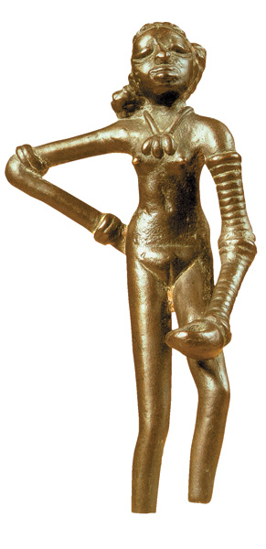
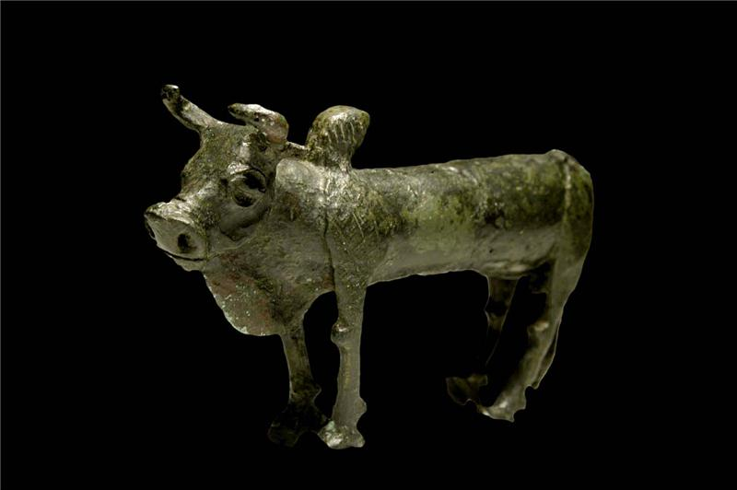
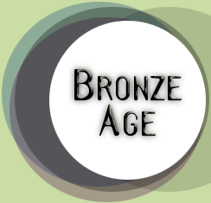
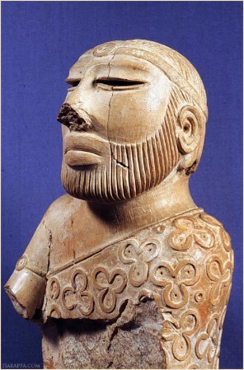
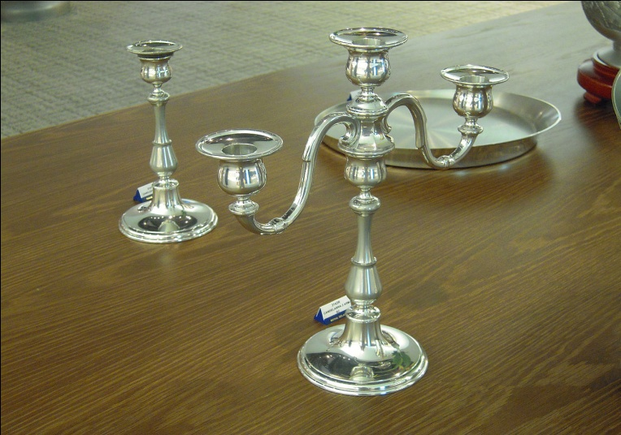

3000 BC
Dancing Girl
a bronze statuette dating around 2500 BC, from the Mohenjo-daro site
Zebu Bull from Mohenjo-Daro and Harappa
Priest king
Mohanjo-daro
Pure tin candlestick
Bronze, an alloy of tin and copper was the first alloy to be used around 3000 BC.
After 600 BC pure metallic tin was produced.

Slide 28
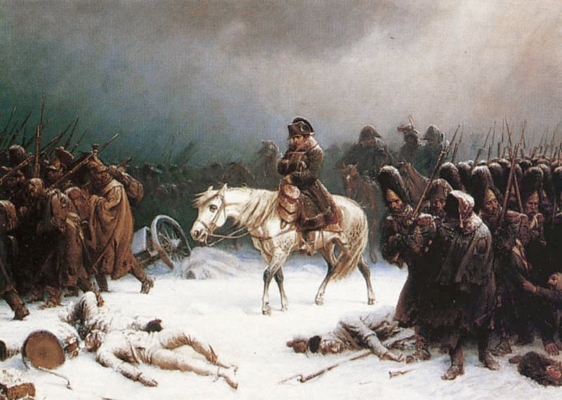
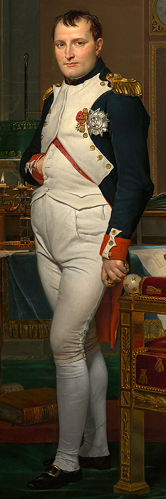
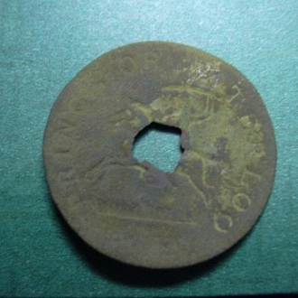
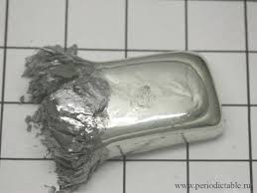
How Napolean Lost the Russian Campaign of 1812
Napolean’s
buttons
At 13.2 °C pure tin transforms from the silvery, ductile metallic allotrope of β-form white tin to brittle, nonmetallic, α-form grey tin with a diamond structure. The transformation is slow to initiate due to a high activation energy very low temperatures of roughly −30 °C aids the initiation.

Slide 29
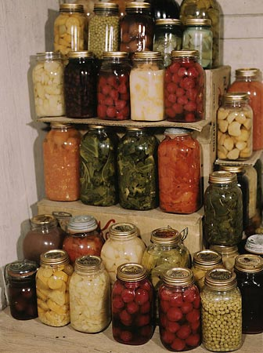
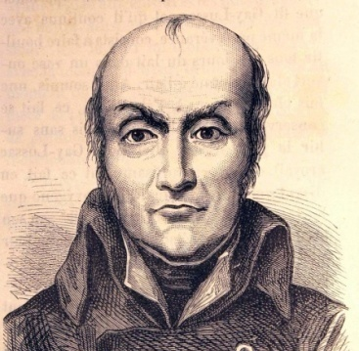
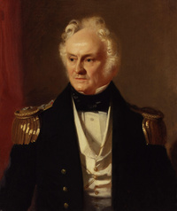
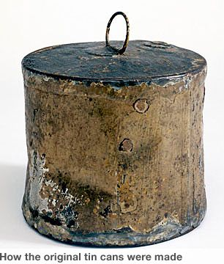
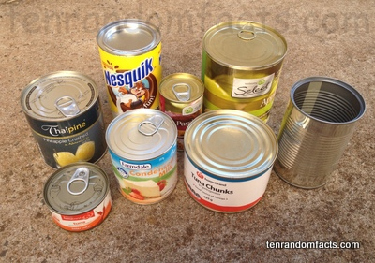
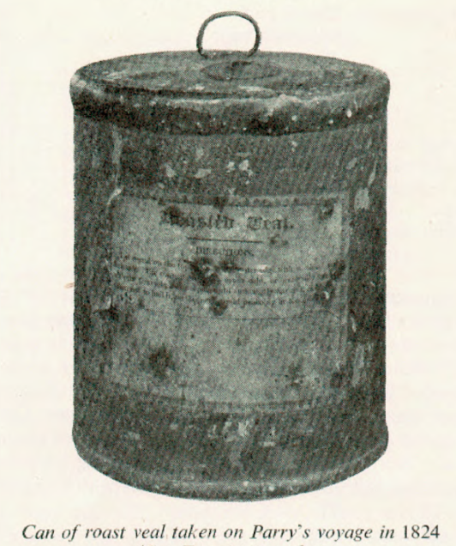
Nicolas Appert 1809 , was the French inventor of airtight food preservation. Appert, known as the "father of canning. Rewarded by Napolean in 1810
Appert
Parry
Peter Durand was an Englishman credited for receiving the first patent to create the tin can in 1810. King George III put an order out for someone to preserve food in "vessels of glass, pottery, or tin" and Durand, a merchant living in Middlesex at the time, had a brilliant idea to do this.
William Edward Parry made two arctic expeditions to the Northwest Passage in the 1820's and took canned provisions on his journeys. One four-pound tin of roasted veal, carried on both trips but never opened, was kept as an artifact of the expedition in a museum until it was opened in 1938. The contents, then over one hundred years old, were chemically analyzed and found to have kept most of their nutrients and to be in fairly perfect condition. The veal was fed to a cat, who had no complaints whatsoever.
Scurvy- Vit C; synthesis of collagen

Slide 30
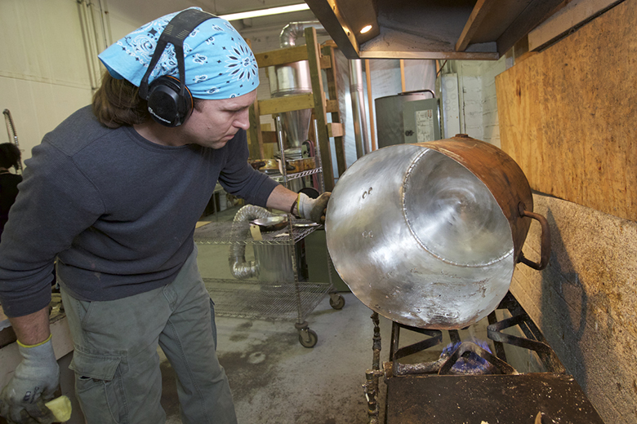
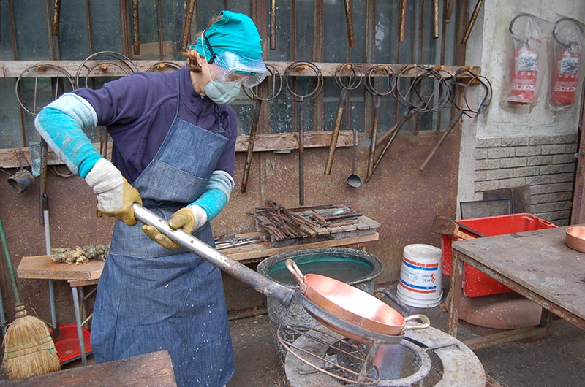
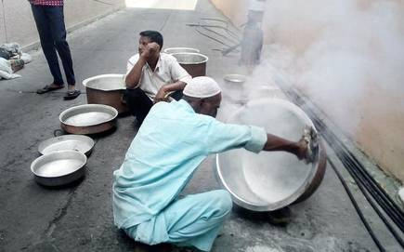
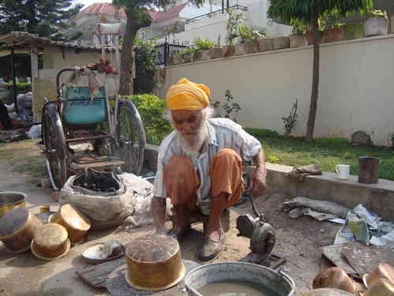
Tinning of copper vessels (using NH₄Cl and Sn) ‘Kalai wala’
Tin has the second lowest melting point (232 °C) among air- and moisture-stable solid metals (comparable melting points: aluminium 660 °C, zinc 419.5 °C, lead 327.5 °C)

Slide 31
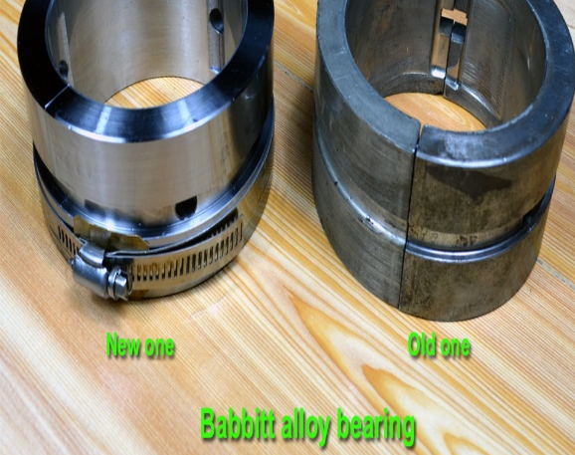
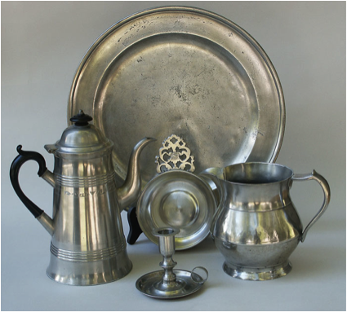
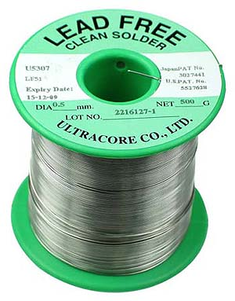
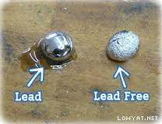
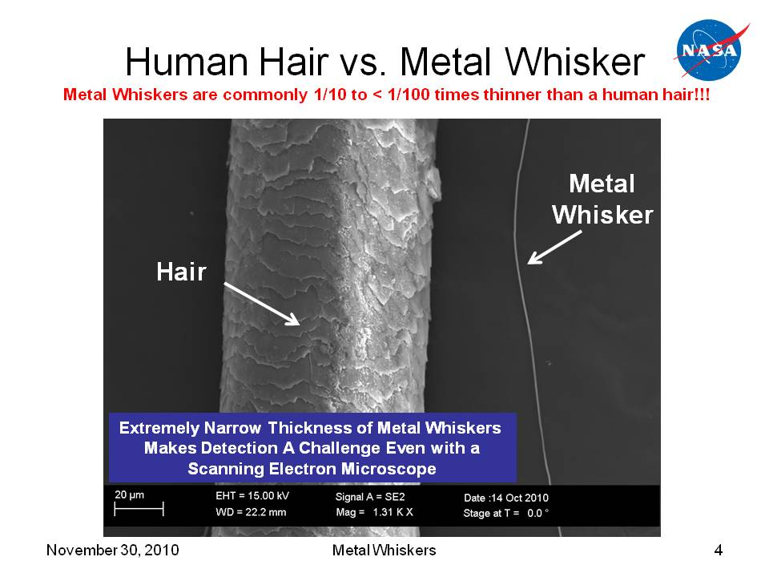
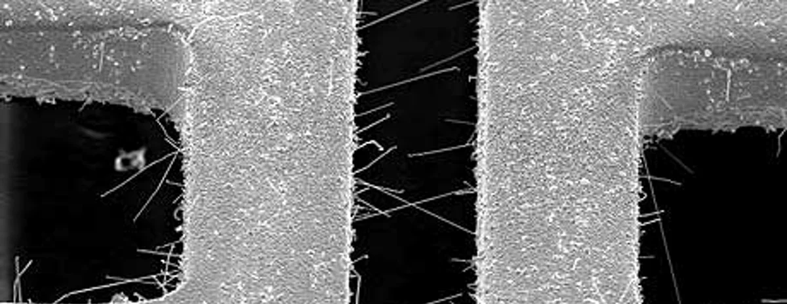
Tin based Alloys
Babbit Sn (86%); Cu (7%); Sb (7%)
Pewter Sn (92%);Cu (2%); Sb (6%)
Bell metal Cu (78 %); Sn (22%)
Pb-Sn solder Sn (63%); Pb (37%)
Lead free solder Sn (95+%); Ag (3%); Cu (1%) (SAC)
Tin whiskers

Slide 32
Stannous chloride
Stannous chloride is a convenient, easily prepared and handled reducing agent. SnCl₂. 2H₂O is prepared by the reaction of hydrochloric acid on tin metal, while the anhydrous form is prepared by the action of HCl gas with tin.
conveniently used for the conversion of aryl nitriles to aldehydes, aryl nitro to amino groups and quinine to hydroquinone.

Slide 33
Tri n-butyltin hydride
Tri n-butyltin hydride is a very good radical reducing agent due to the relatively weak, nonionic bond between tin and hydrogen (Bu₃Sn-H 74 kcal/mol) that can cleave homolytically. It is is used as a source of hydrogen atoms in organic synthesis. Reaction of silyl monohydrides such as Ph₃SiH, Bu₃SiH or polymethylhydrosilane with tributyltin oxide results in its formation.
The process happens by a radical chain mechanism involving the radical Bu₃Sn•. Along with a free radical initiator like AIBN, tributyltin hydride generates the tributyltin free radical. This radical can cleave an alkyl/aryl halide bond forming a free radical and Bu₃SnX. Another molecule of Bu₃SnH provides a hydrogen free radical for making an alkyl-aryl hydrogen bond and propagates the radical chain reaction.

Slide 35
Trimethyltin fluoride is the simplest member of the group of triorganyltin fluorides. It is prepared by halogen exchange reaction of (CH₃)₃SnCl with KF or NaF in a water ethanol mixture.
Herbert Roesky and coworkers first showed the synthetic utility of this compound as a very convenient, highly efficient and recyclable fluorinating agent for group 4 to 6 organometallic compounds and some main-group chlorides

Slide 36
Tetraethyl lead as an antiknock agent
J.R. McNeill an environmental historian remarked that Midgley had more impact on the Earth’s atmosphere than any other living organism due to his inventions: namely, lead gasoline additives and chlorofluorocarbons.
Thomas Midgley Jr

Slide 37
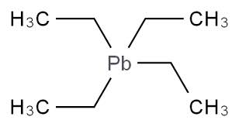
Tetraethyl lead (TEL) has weak C–Pb bonds (130 kj/mol ; C-C 346 kj/mol). The compound is air and moisture stable and is purified by steam distillation. It is soluble in gasoline. At the temperatures found in internal combustion engines, (CH₃CH₂)₄Pb decomposes completely into lead and lead oxides as well as combustible, short-lived ethyl radicals. Lead and lead oxide scavenge radical intermediates in combustion reactions. Engine knock is caused by a cool flame, an oscillating low-temperature combustion reaction that occurs before the proper, hot ignition. Lead quenches the radicals and thus kills the radical chain reaction that would sustain a cool flame, preventing it from disturbing the smooth ignition of the hot flame front. Lead itself is the reactive antiknock agent, and TEL serves as a gasoline-soluble lead compound. When TEL burns, it produces not only carbon dioxide and water, but also lead:
This lead can oxidize further to give species such as lead(II) oxide:
Pb and PbO would quickly over-accumulate and destroy an engine. For this reason, the lead scavengers 1,2-dibromoethane and 1,2-dichloroethane are used in conjunction with TEL—these agents form volatile lead(II) bromide (B. P 916 °C), and lead(II) chloride (B. P 954 °C), respectively, which are flushed from the engine and into the air.

Slide 38
Use of lead and lead based compounds are on a sharp decline in the last 3-4 decades after realizing the high toxicity of lead. The Centers for Disease Control (USA) has set the upper limit for blood lead for adults at 10 µg/dl (10 µg/100 g) and for children at 5 µg/dl. It causes almost 10% intellectual disability and can result in behavioral problems. Some of the effects are permanent. In severe cases anemia, seizures, coma, or death may occur. Chelation therapy has been found to be useful for removing lead from the body
Lead was one of the major components of solders used for electrical soldering. Well known solders such as 60/40 Sn-Pb, which melts at 188 °C and 63/37 Sn-Pb were used principally in electrical/electronic work. 63/37 is a eutectic alloy of these metals, which has the lowest and sharp melting point (183 °C) of all the tin-lead alloys.
Rechargeable battery | Property and Applications
Lead Acid | Highly economical for larger power applications where weight does not matter. Preferred choice for automobiles, for hospital equipment, emergency lighting and UPS systems. Inexpensive
Nickel Cadmium | Used where long life, high discharge rate and economical price are important. Main applications in biomedical equipments, professional video cameras and power tools. Contains toxic cadmium. Relatively low in energy density. Expensive
Ni Metal Hydride | Has a higher energy density compared to the NiCd at the expense of reduced life. NiMH contains no toxic cadmium. Applications include mobile phones and laptop computers. Expensive
Lithium ion | Fastest growing battery system. Used where high-energy density and lightweight is of prime importance. Applications include computers and cellular phones. Expensive
Lithium polymer | Has the attributes of the Li-ion but in smaller in size. Main application is in mobile phones. Expensive

Slide 39
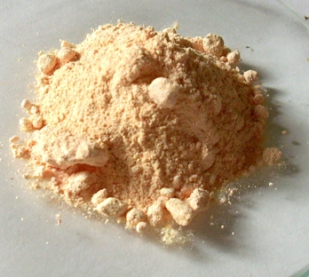
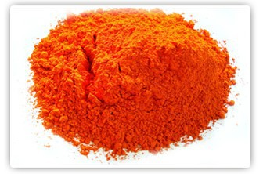
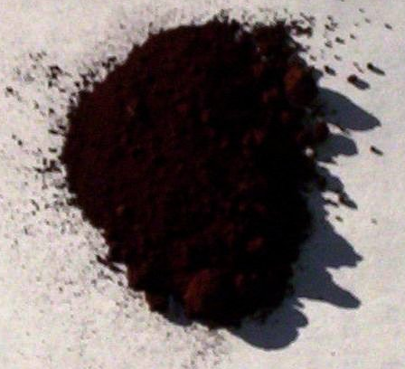
Oxides of lead
Lead forms three different oxides. PbO, Pb₃O₄ and PbO₂.
Lead (II) oxide, PbO is the product obtained on oxidation of galena (PbS) at about 1000 °C. It is also obtained from the thermal decomposition of some lead salts such as Pb(NO₃)₂ or PbCO₃. PbO is an amphoteric oxide. The color varies from yellow to red. PbO is extensively used in making lead glass or crystal glassware
Lead (II, IV) oxide triplumbic tetroxide Pb₃O₄, is a red colored oxide is obtained by calcinations of PbO in oxygen at around 480 °C. It is also obtained by heating of lead carbonate in air. Its main use is as a red pigment for making primer paints.
Lead (IV) oxide, PbO₂ is a dark brown crystalline powder which is poorly soluble in water. It is a strong oxidant. It is prepared by oxidation of Pb₃O₄ by oxidizers such as chlorine, hypochorite or nitric acid. It is also obtained by oxidation of Pb(OAc)₂ with calcium hypochorite. It reacts with acids such as H₂SO₄ and HNO₃ liberating oxygen gas. The most important use of PbO₂ is in lead acid batteries.

Slide 40
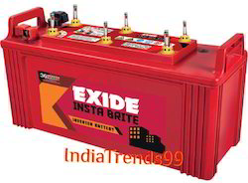
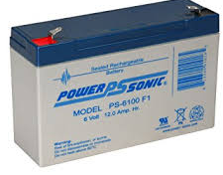
Lead Acid Batteries
Most important application of lead is in lead acid storage batteries for which more than 85% of the world production of lead is currently used.

